Slide 1
Force Field Transformation
Ganiyu Ibraheem & Philipp Seybold
Advanced Computer Vision

Slide 2
Overview
Definition
Method Application
Demonstration
Result
Discussion

Slide 3
Definition
Objective:
Reduce dimensionality of pattern space
Maintain discriminator power
By: David J. Hurley, Mark S. Nixon & John N. Carter
Domain: Ear & face recognition
Notes:
Objective:
reduce dimensionality of pattern space
yet maintain discriminator power for classification and invariant description
Used/invented by … for ear biometric

Slide 4
Method
Approaches:
Pixel by Pixel
Frequency Domain Analysis
Steps:
Image to force field transformation
potential well and channel extraction
Notes:
Approaches:
Brute Force: Each pixel is transformed using the Energy & Force equations
Frequency Domain Analysis: Fourier Transform etc. and then equations applied

Slide 5
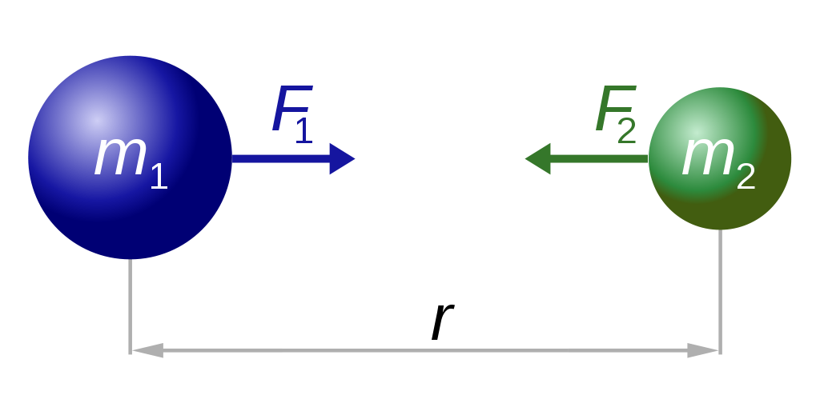
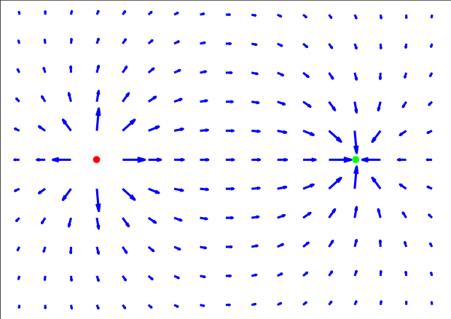
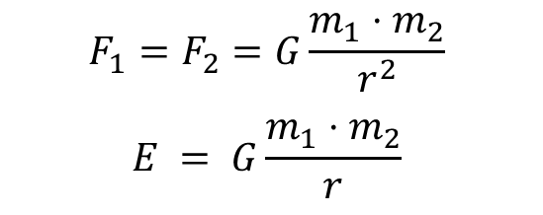
Method
Assumption: Each pixel exerts an isotropic force proportional to its intensity
$$F_{1}=F_{2}=G\frac{m_{1}⋅m_{2}}{r^{2}}$$
$$E = G\frac{m_{1}⋅m_{2}}{r}$$
Force field vectors of an electric field
Newton's law of gravitation
Notes:
Assumption: (for mathematical convenience): Each pixel exerts an isotropic force on all the other pixels (they represent attractive particles, that act as the source of a spherically symmetric force field) that is proportional to pixel intensity and inversely proportional to the square of the distance, i.e. the inverse square law

Slide 6
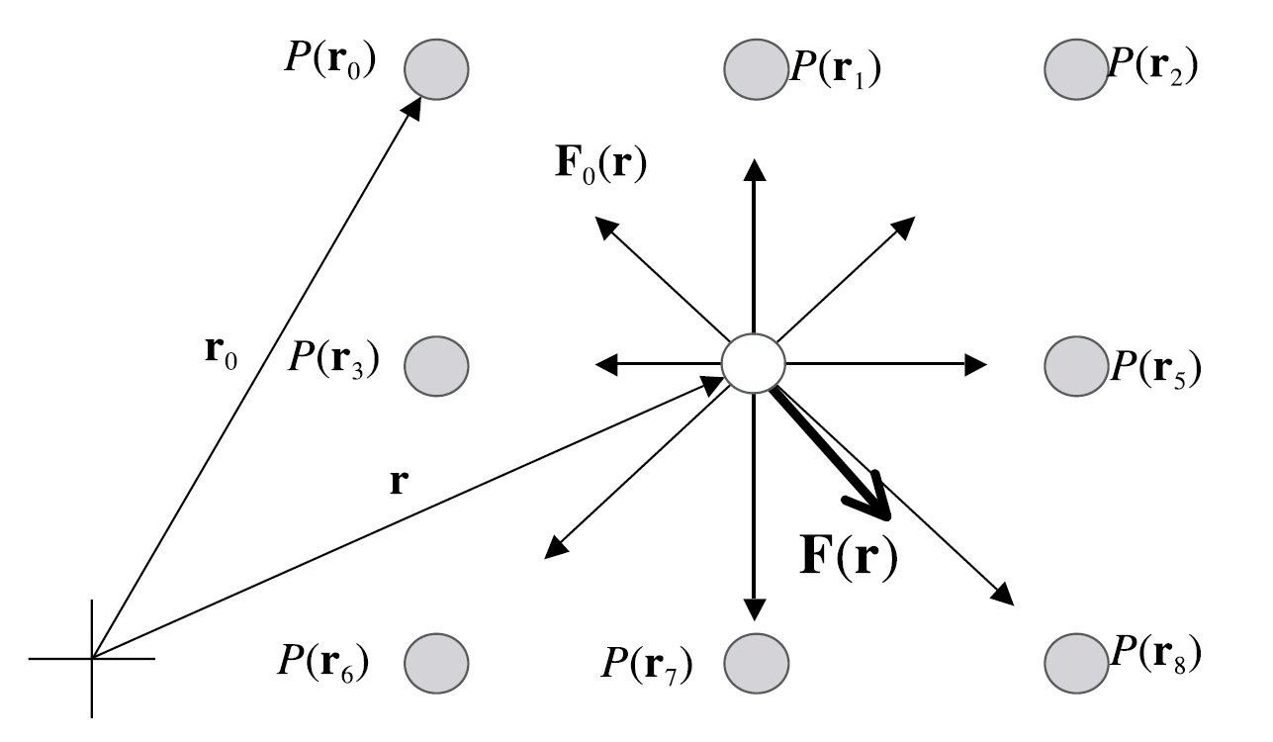

Method
$$F_{i}\left(r_{j}\right)= …= P\left(r_{i}\right)\frac{r_{i}−r_{j}}{{\left|r_{i}−r_{j}\right|}^{3} }$$
$$E_{i}\left(r_{j}\right) =$$
Notes:
Assumption: (for mathematical convenience): Each pixel exerts an isotropic force on all the other pixels (they represent attractive particles, that act as the source of a spherically symmetric force field) that is proportional to pixel intensity and inversely proportional to the square of the distance, i.e. the inverse square law

Slide 7
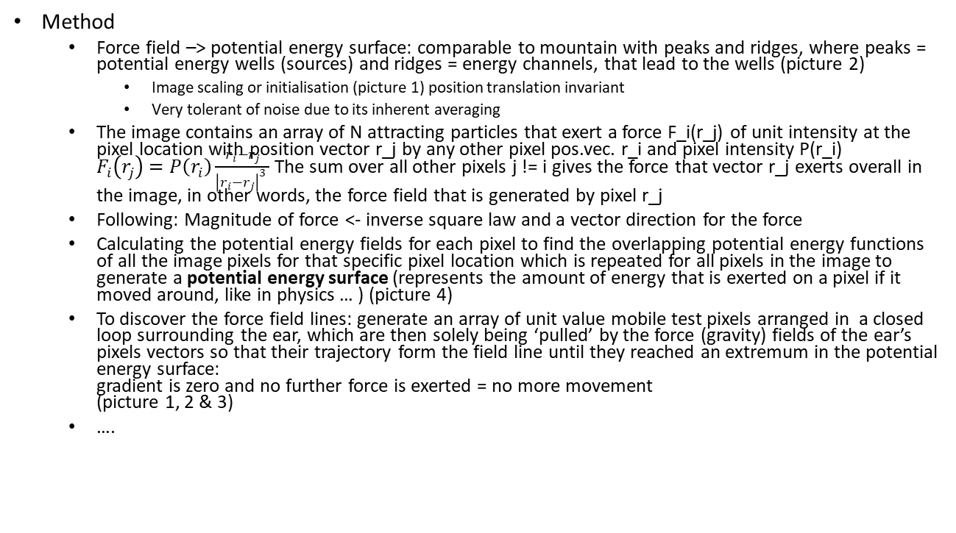
Method Application
Method
Force field –> potential energy surface: comparable to mountain with peaks and ridges, where peaks = potential energy wells (sources) and ridges = energy channels, that lead to the wells (picture 2)
Image scaling or initialisation (picture 1) position translation invariant
Very tolerant of noise due to its inherent averaging
The image contains an array of N attracting particles that exert a force F_i(r_j) of unit intensity at the pixel location with position vector r_j by any other pixel pos.vec. r_i and pixel intensity P(r_i) $F_{i}\left(r_{j}\right)=P\left(r_{i}\right)\frac{r_{i}−r_{j}}{{\left|r_{i}−r_{j}\right|}^{3} }$The sum over all other pixels j != i gives the force that vector r_j exerts overall in the image, in other words, the force field that is generated by pixel r_j
Following: Magnitude of force <- inverse square law and a vector direction for the force
Calculating the potential energy fields for each pixel to find the overlapping potential energy functions of all the image pixels for that specific pixel location which is repeated for all pixels in the image to generate a potential energy surface (represents the amount of energy that is exerted on a pixel if it moved around, like in physics … ) (picture 4)
To discover the force field lines: generate an array of unit value mobile test pixels arranged in a closed loop surrounding the ear, which are then solely being ‘pulled’ by the force (gravity) fields of the ear’s pixels vectors so that their trajectory form the field line until they reached an extremum in the potential energy surface: gradient is zero and no further force is exerted = no more movement (picture 1, 2 & 3)
….

Slide 8
Demonstration
Our own ears pictures etc. like in method application, e.g. force field lines, moving test pixel initialisation, peaks/wells, edges (compare to sobel?), potential energy patterns
Live demo with camera

Slide 9
Result
Advantages:
Simplified implementation in time domain
Time complexity reduced due to working in frequency domain: O(n * log(n))
Impervious to distortion in image due to motion
Finds application in edge detection
Higher efficiency (99.2%) as compared to other techniques
The Force Field Transforms are invertible
It is scale invariant and tolerant to low noise
Also invariant to different changes in illumination
Disadvantages:
At times, transform generates only one ‘well’ (source, origin)
High computational costs for brute-force method: O(n²)
Not widely applicable
Occlusion by hair

Slide 10
Result
Other application areas?

Slide 11

Discussion
Any Questions?

Slide 12
Sources
3 Papers
Marks book
Linkedin slides
Git repo from that guy (maybe)

